Slide 1
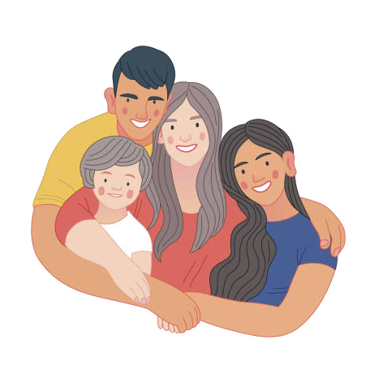
DESIGN IDEAS
FROM TEAM 09

Slide 2



OUR THREE DESIGN IDEAS
Your World on the Board (YWB)
imagiNATION
Guess the meaning!

Slide 3
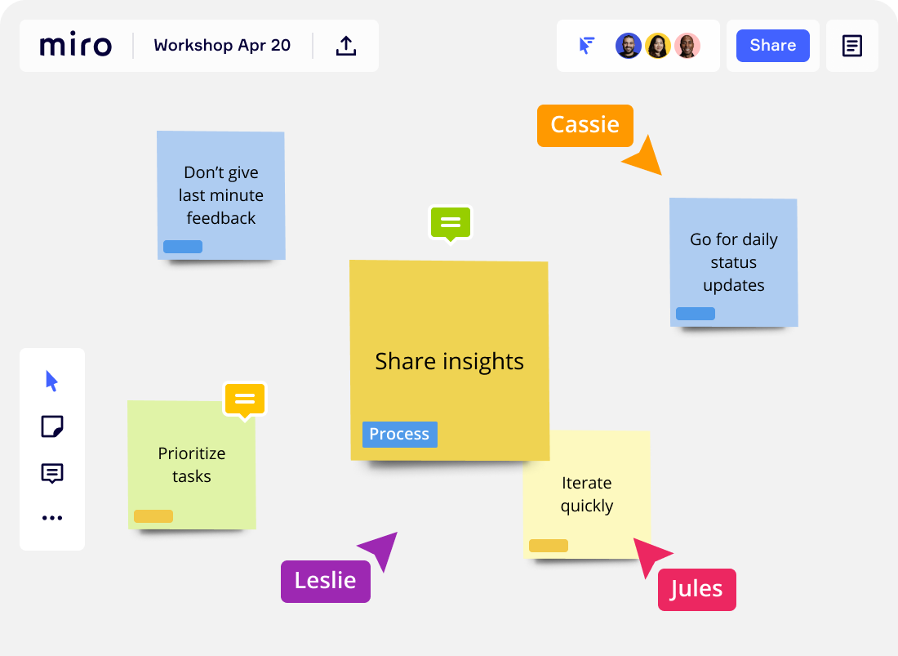
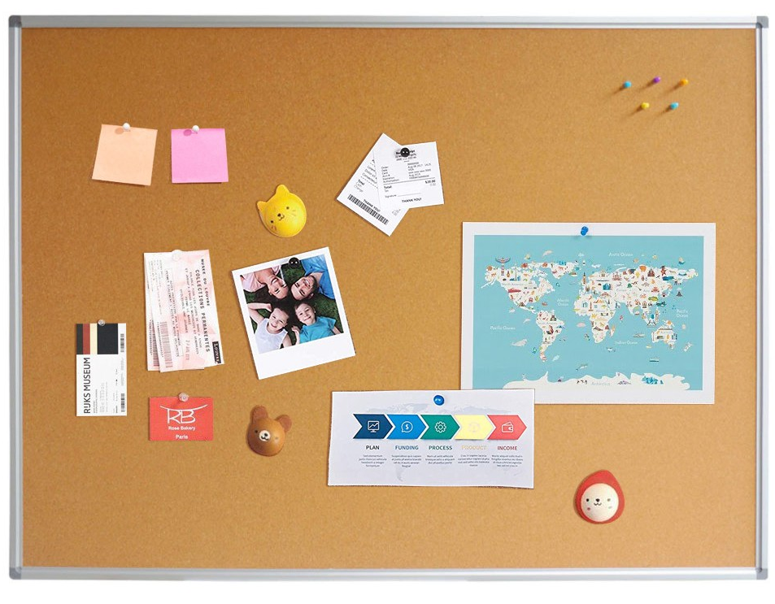
Your World on the Board (YWB)
This app can implement mutual understanding, with the aim of improving transcultural connection.
We proposed a virtual board in which every day users have to complete a task by posting pictures, videos or words.
All family can use this app and on the board there are sticky notes, in which family members can easily translate what they write or read.

Slide 4
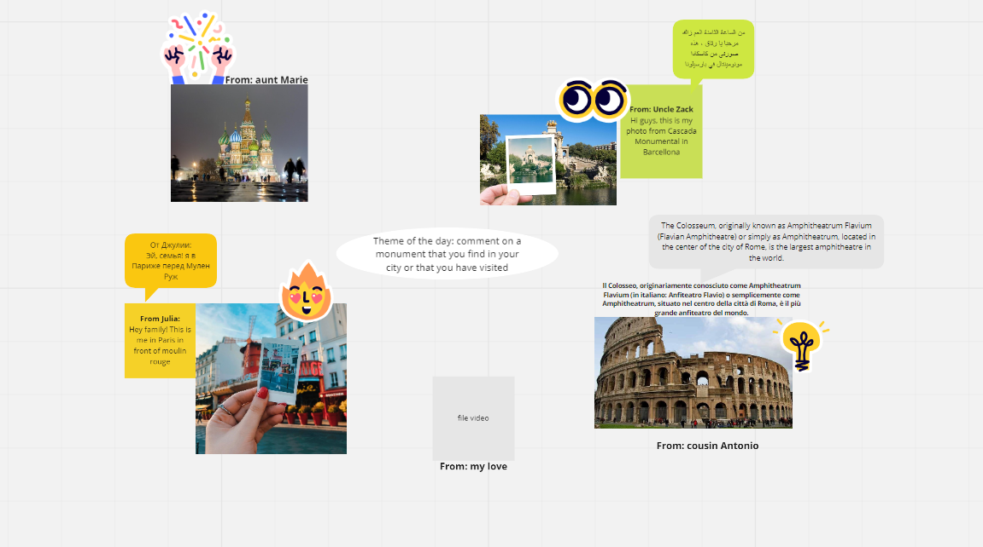
Your World on the Board (YWB)

Slide 5
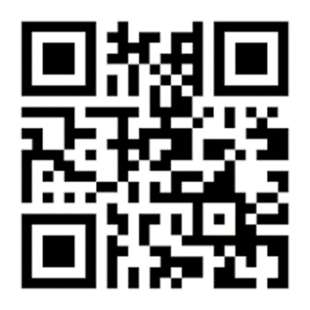
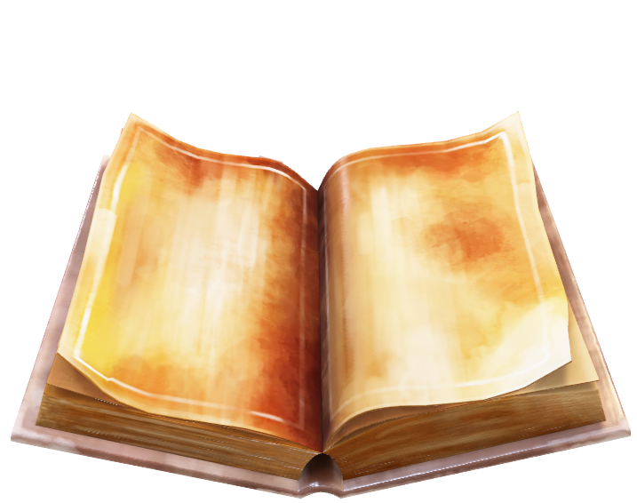
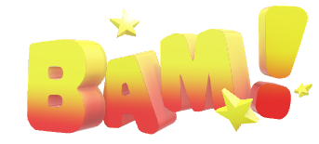
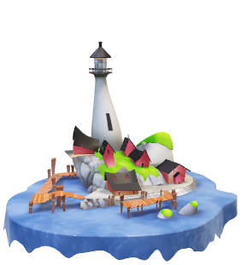
imagiNATION
This book can represent a bridge between older and younger generation. In fact, it creates sharing times in which grandparents and grandkids, for example, can easily interact with each other.
The book tells, with pictures, a multicultural novel. Users can frame a page and then appears an object or a character of the novel, in augmented reality with translation of the text added.

Slide 6
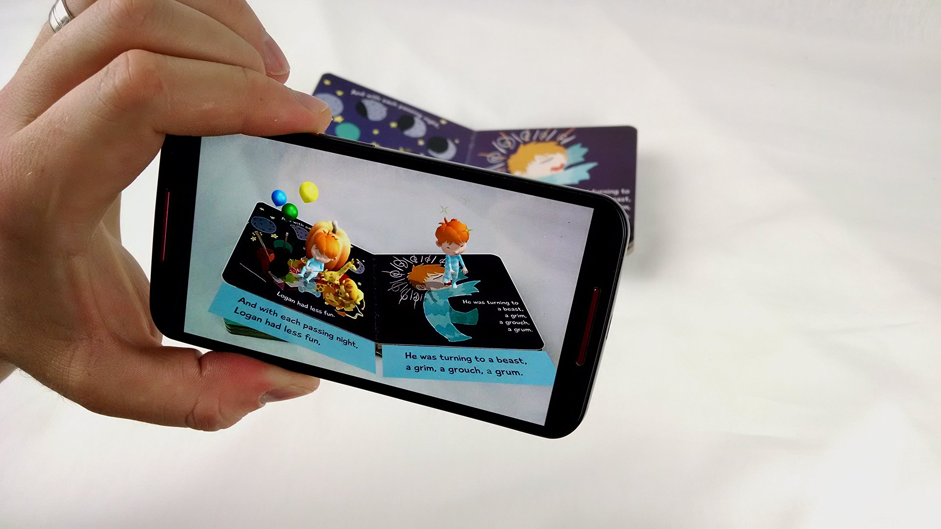
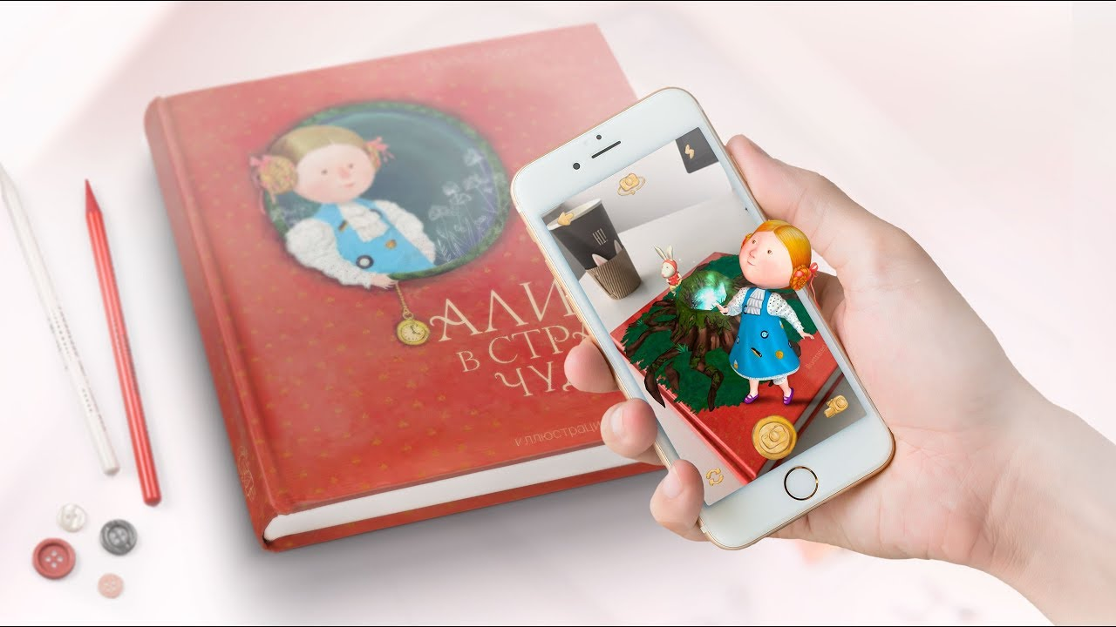
imagiNATION

Slide 7
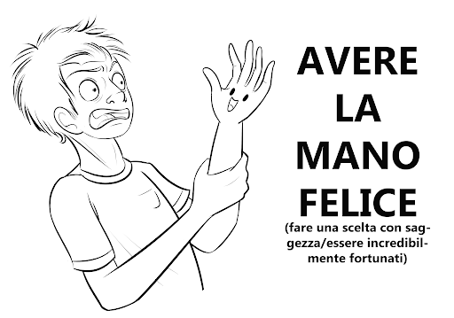
Guess the meaning!
In order to improve family offline meetings, we thought about a game based on funny idioms.
In this game users have the opportunity to match the picture of an idiom with its written form.
This means make a wise choice / being incredbly lucky

Slide 8
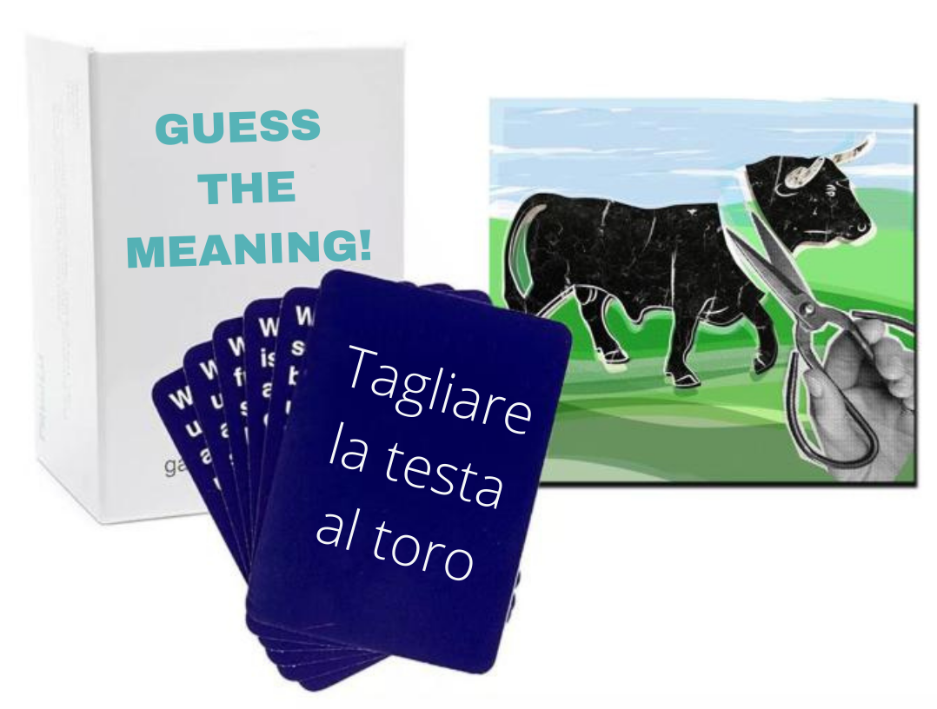

Guess the meaning!

Slide 9

Let us know the idea you like the most!

