Slide 1
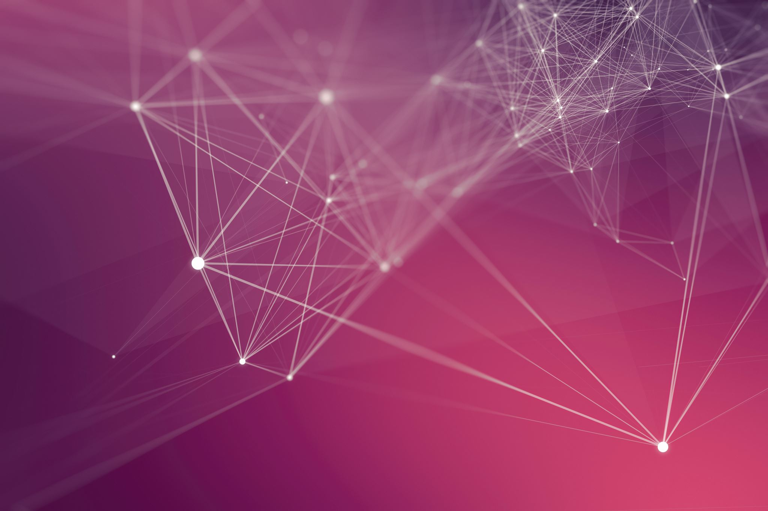
Five sense The explanation of our choices
Babilonia's Team

Slide 2
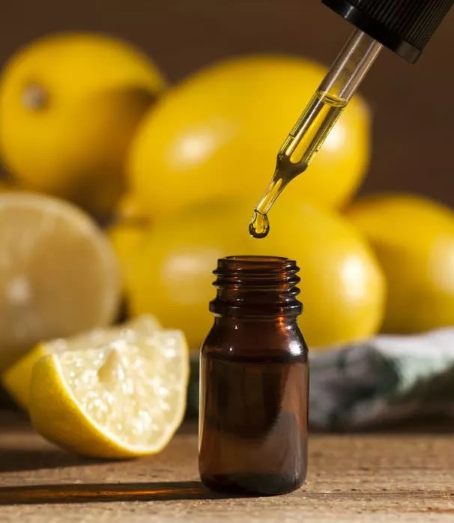
Sense of smell
The scents of citrus fruits have beneficial effects on the body, with antiseptic functions, and on the mind, acting on stress and improving mood. Each citrus fruit is unique thanks to its own olfactory notes. Lemon essential oil is excellent for concentration, tonic for intellectual functions and stimulates the nervous system. Widespread in the environment, it puts you in a good mood and decreases the typing errors of those who work at the computer.

Slide 3
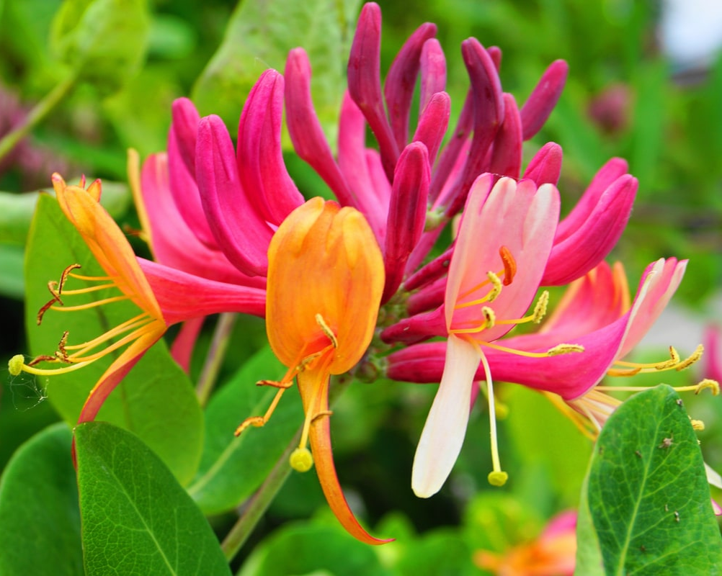
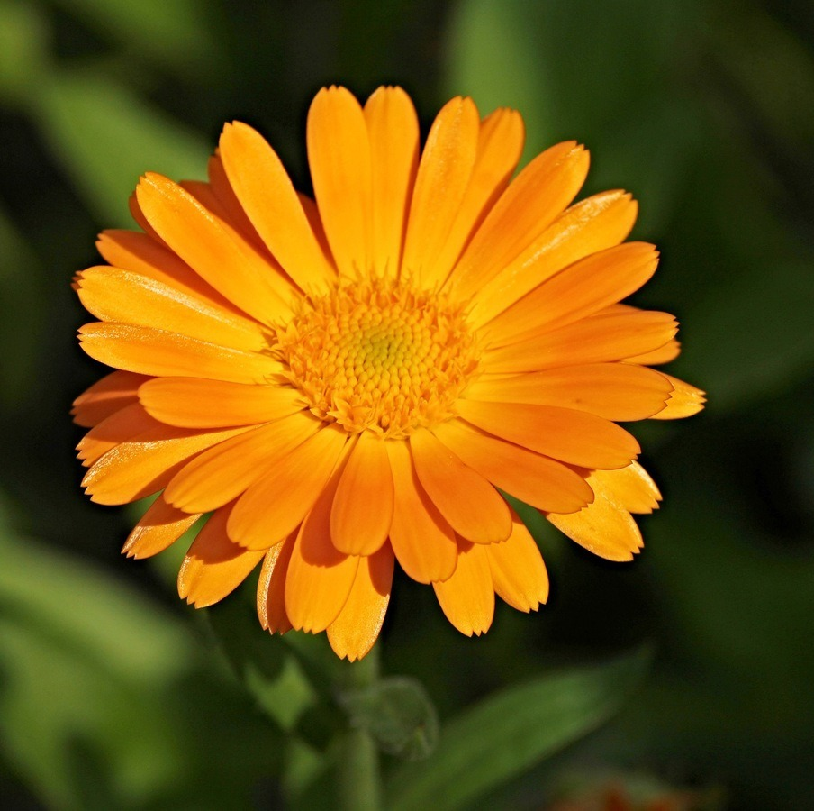
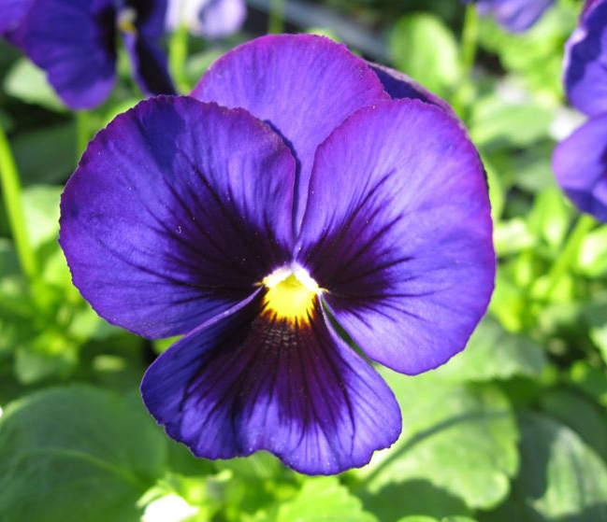
The scents of flowers are the noblest and represent the highest human emotions. These perfumes instill lightheartedness, joy and euphoria, in fact they are the basis of aromatic treatments against stress and anxiety. Often associated with women, who make more use of it, they can also be worn by men, bringing out their irrational and artistic side.

Slide 4
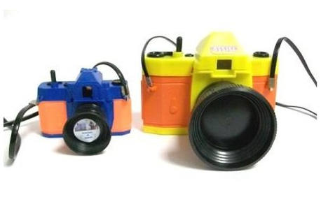
Phototherapy
Therapeutic photography is a discipline that invites the use of photographs as a vehicle for reflection and change. The quality of the photographs is irrelevant: blurry, creased, random… any photograph is suitable for this type of therapy. The work with photographs allows first of all to know and give voice to the point of view of the person, thus intervening directly on the narration that this person makes of his experiences, his person and his relationships. The image is constantly a mirror in which to re-know oneself and re-know one's history and possibilities.

Slide 5
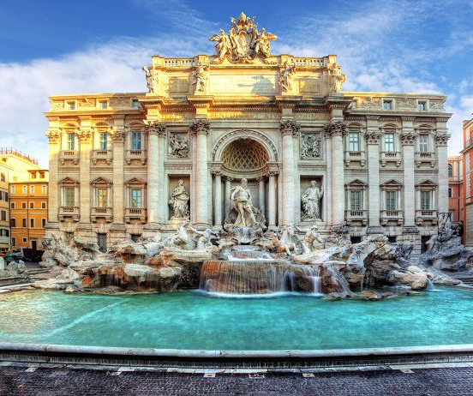
"Every photograph that a person collects is basically a piece of a gigantic self-portrait that represents him."
Judy Weiser

Slide 6
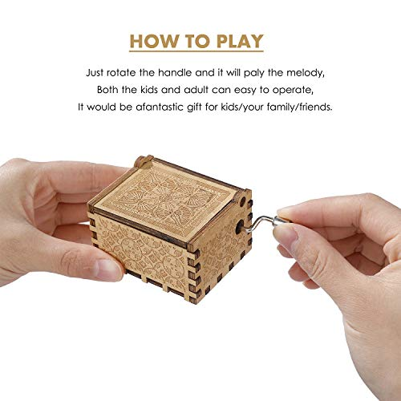
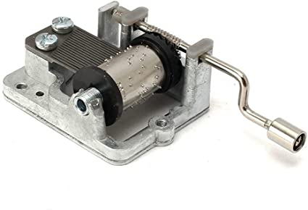
Music in psychology
Music keeps man company in his activities and helps him to express his emotions. It has been studied that music activates several brain areas at the same time, in other words music produces brain plasticity. Recent discoveries that show that listening to music is a rewarding experience and that simply listening to music activates the dopaminergic system of gratification offer even more support to the idea that musical practice can be the perfect tool for rehabilitation.
Internal mechanism

Slide 7
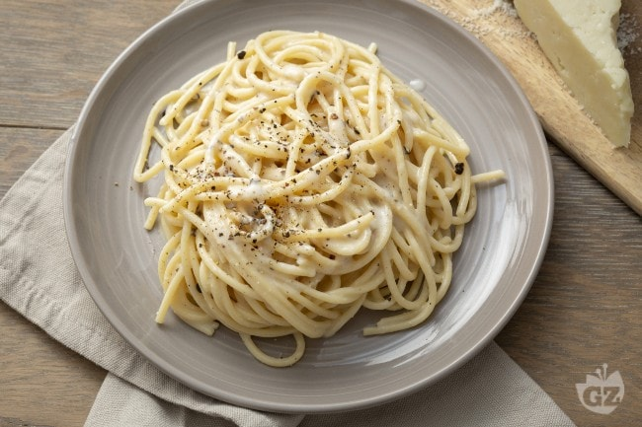
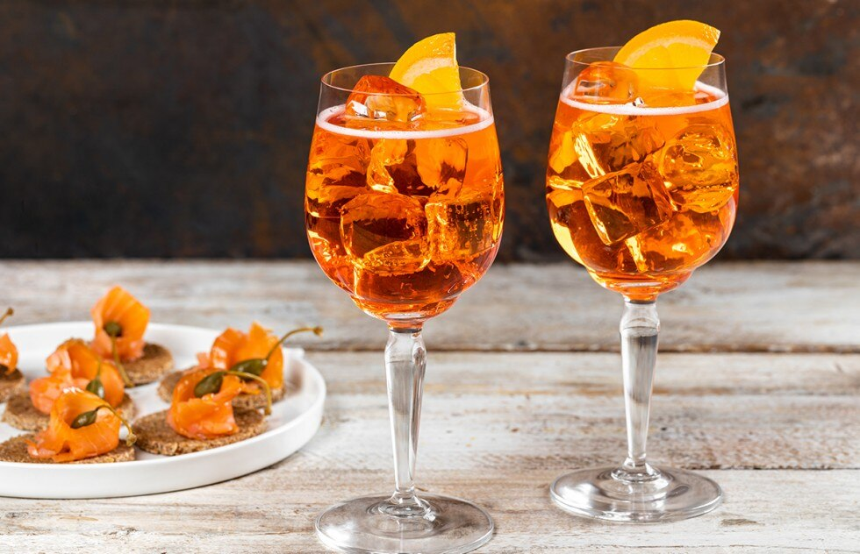
Cooking and psychology
The kitchen has the power to abstract us from what surrounds us, it takes away other thoughts and makes us focus on the present moment. Cooking is a way to show affection and attention to those close to us and will share those dishes with us. Cooking is also a creative act, for example when we choose the ingredients. Finally, when we cook we take care of ourselves, we dedicate time deciding what we want and gratifying ourselves with the final result.

Slide 8
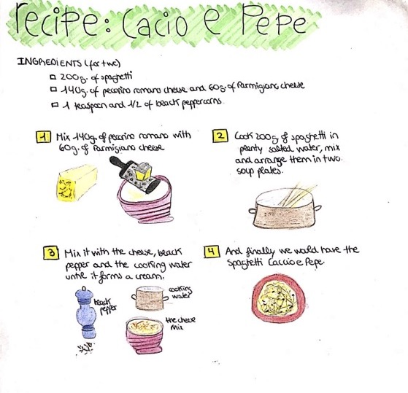
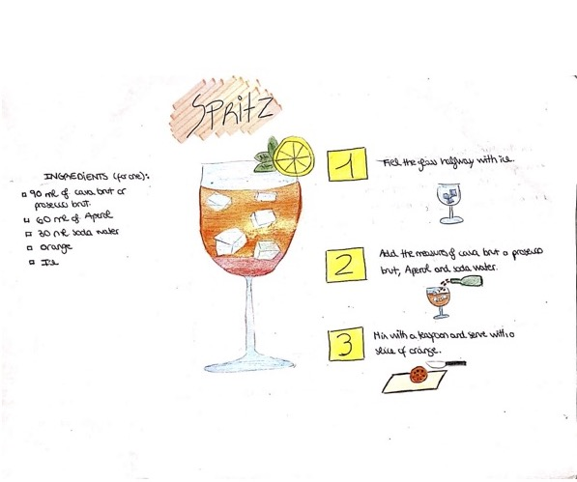
Cooking Therapy
The goal of Cooking Therapy is to make food preparation a creative act where THE SENSES (smell, touch, sight, taste, hearing) find the right balance and the meeting point with our historical memory, a personal recipe book from which one to draw to transform emotions and memories into RECIPES that consolidate our personal identity and are transmitted with love to the other.

Slide 9
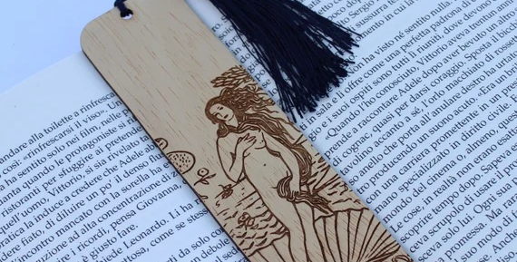
Reading is therapeutic
Over the decades, several researches have shown that reading activates the same neurons that are activated when we also practice other activities, such as writing, running or simply touching an object. It is as if we ourselves did what we see the imaginary characters whose stories we follow do. Not only! According to other studies, reading is also an effective way to improve our ability to empathize with others, get involved and feel empathy, and even a way to relax.

Slide 10
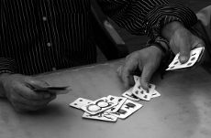
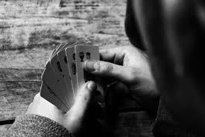
The psychology of the card game
According to the doctors of the St. Michael Hospital in Toronto who conducted the study, card games allow you to train the mind and more. Card games are a good pastime, they are valid expedients to keep the mind in action (memory, attention, reasoning, calculation, strategy), they are socializing. In the card game it is necessary to learn to control one's emotions. It is essential, in fact, not to show one's reactions to prevent the opponent from gaining an advantage. This ability is also useful in other situations in life, in which those who play cards find themselves more trained. Even from a psychological point of view in the card game there are different skills that you go to train. For example, it is useful to learn to read the opponent's psychology and its metacommunication or non-verbal communication, capturing the variations in posture and facial expressions.

