Slide 1
Final Concept Wall of Creativity
by Team №2 “ArtVector”

Slide 2
INDEX
01 CONCEPT IDEAS
02 PLANS AND MEASURES
03 LOGO
04 OVERVIEW
05 MATERIALS AND FABRICATION PROCESS

Slide 3
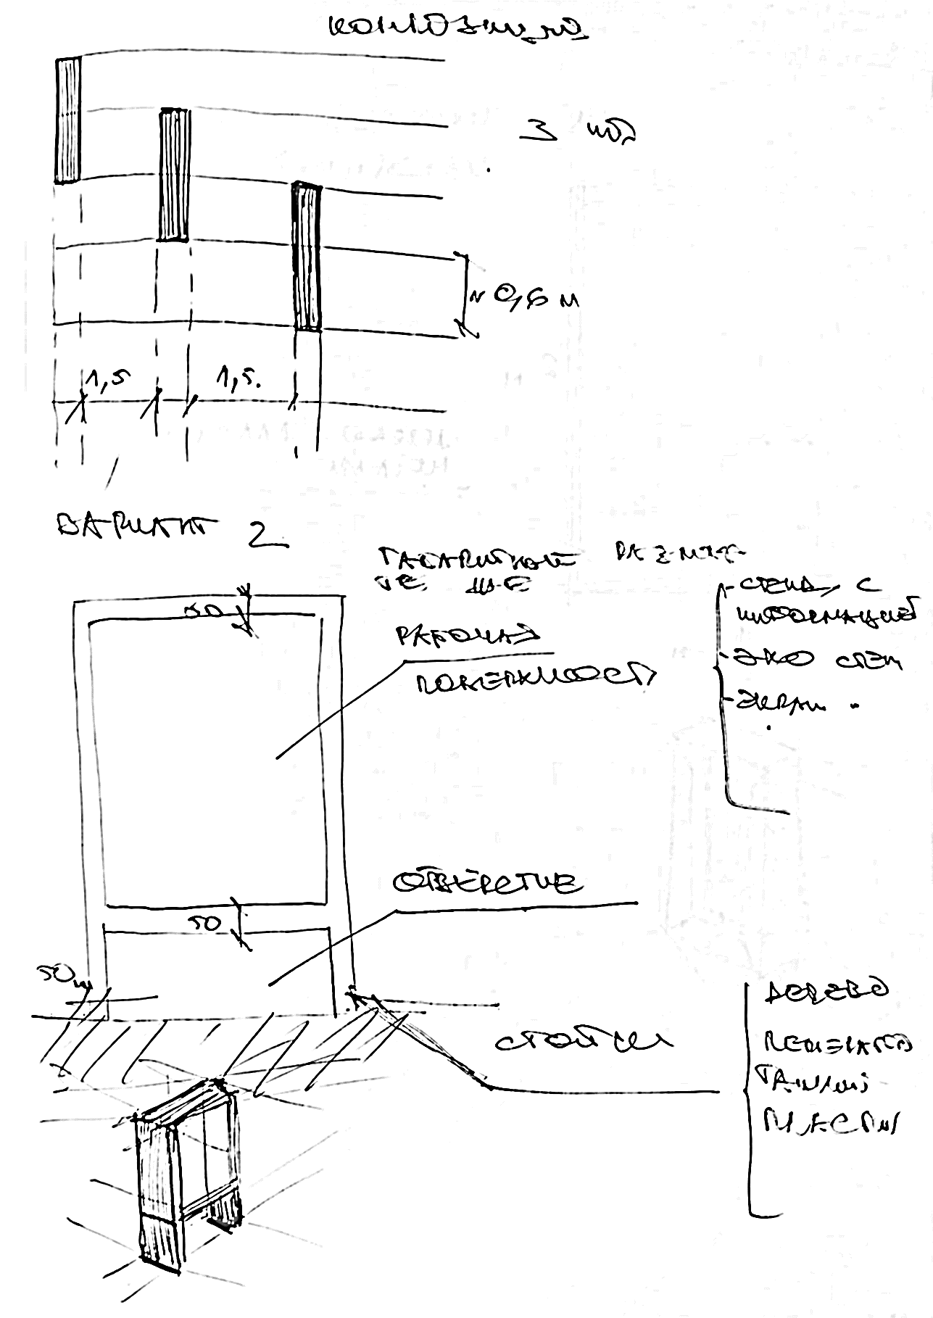
01
CONCEPT IDEAS
Wall thickness 20 cm
— Information desk
— drawing panels are made of recycled plastic
— explication
work surface
composition
hole
stands
— wood
—recycled plastic

Slide 4
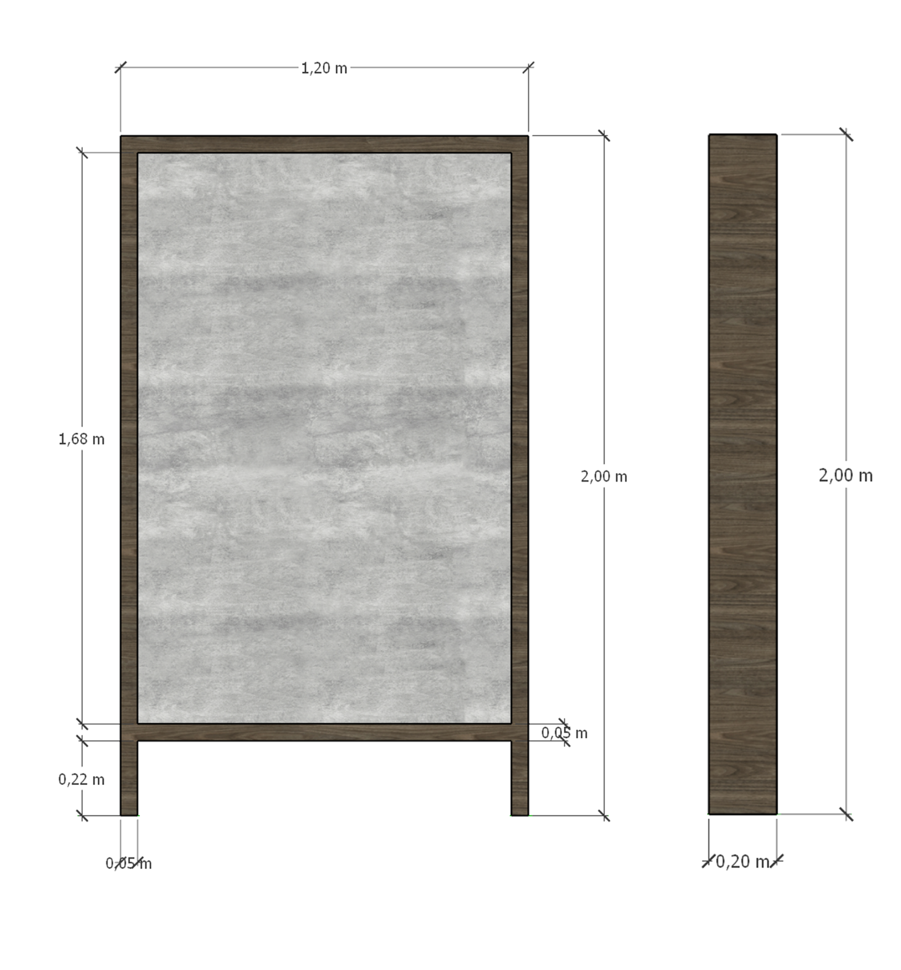
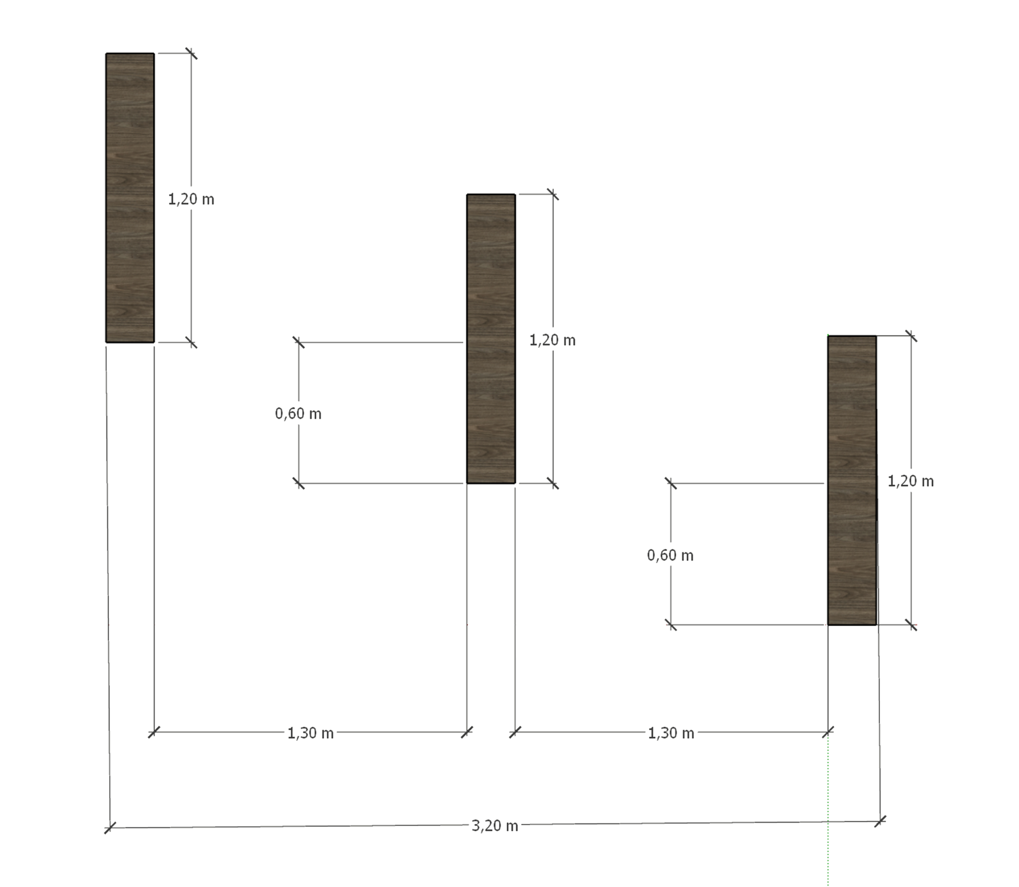
02
PLANS AND MEASURES
plan
facades

Slide 5
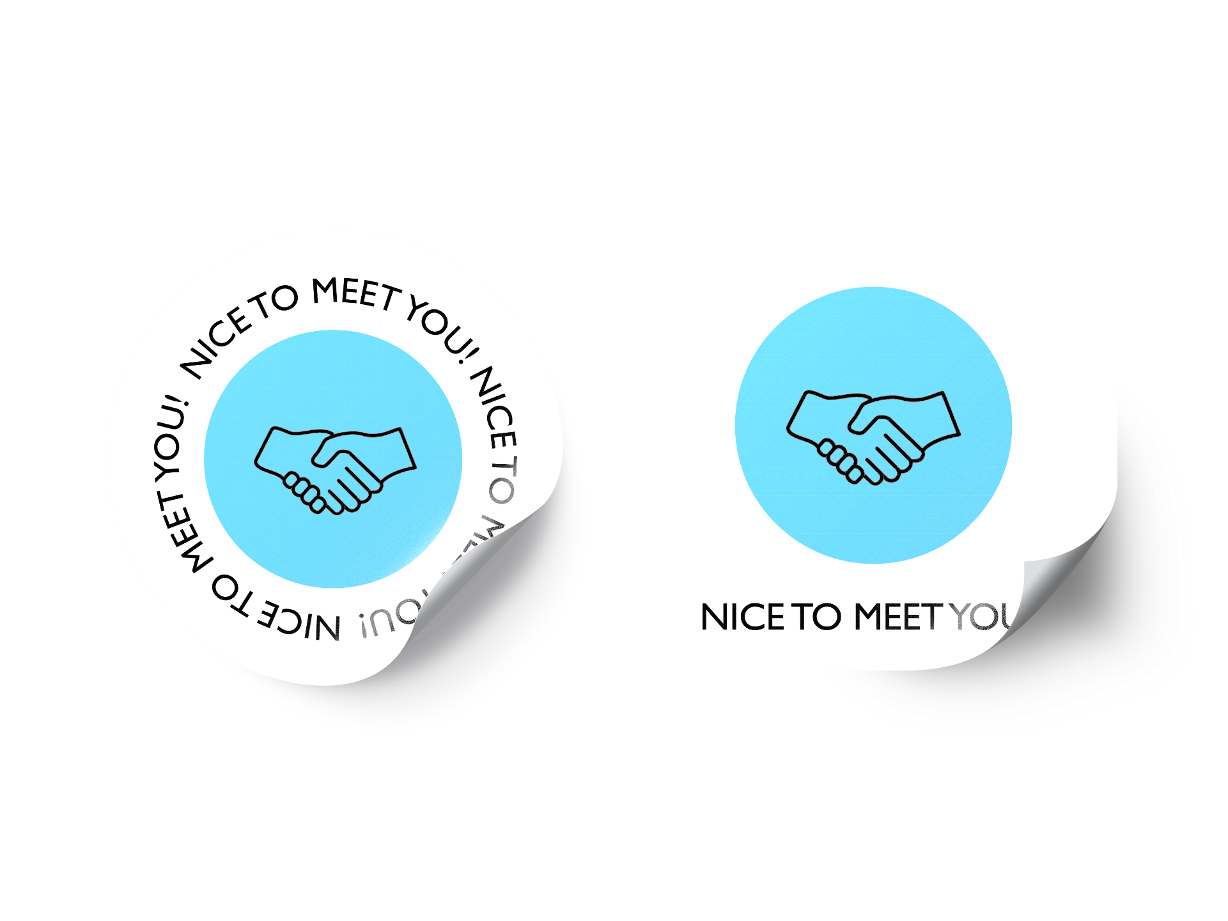
03
LOGO
We also offer stickers for bar chairs and tables. This will help to improve the social lives of people who are lonely and those who have difficulties in communicating. A person just has to sit down for a place like this - that means he’s open to communication..

Slide 6
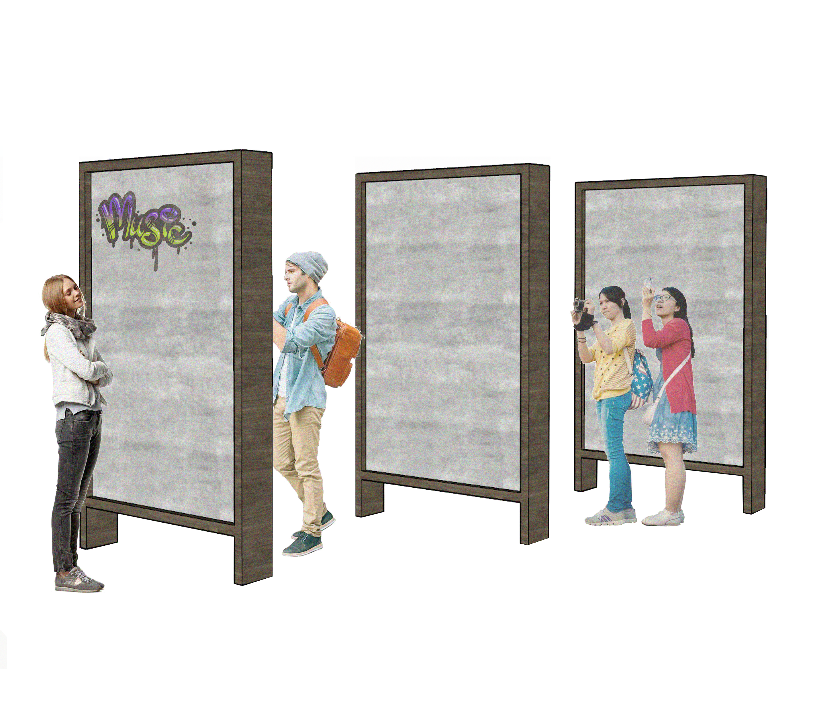
04
OVERVIEW
This is how the walls will look. An unusual object will make people tear themselves away from mobile phones.
They will leave their drawings, tags and accounts in social networks, find each other and communicate more.

Slide 7
05
MATERIALS AND FABRICATION PROCESS
wood
concrete
recycled plastic

