Slide 1
TEREZA FASHION WEEK
Architectural conception of pavilion
By Team 3 for Team 12

Slide 2
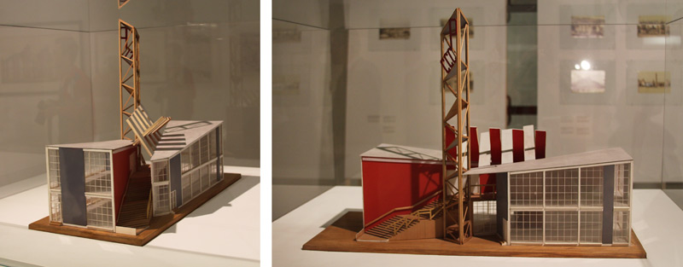
Constructivism

Slide 3
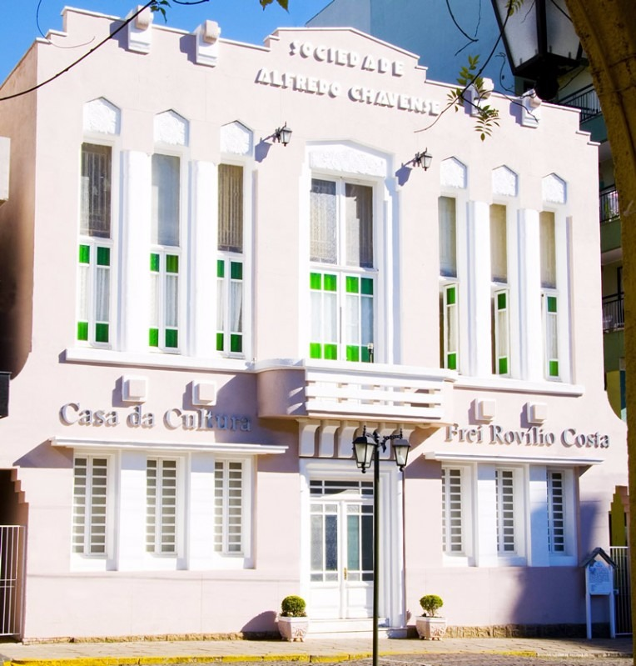
Local architecture

Slide 4
General conception

Slide 5
Colors and forms

Slide 6
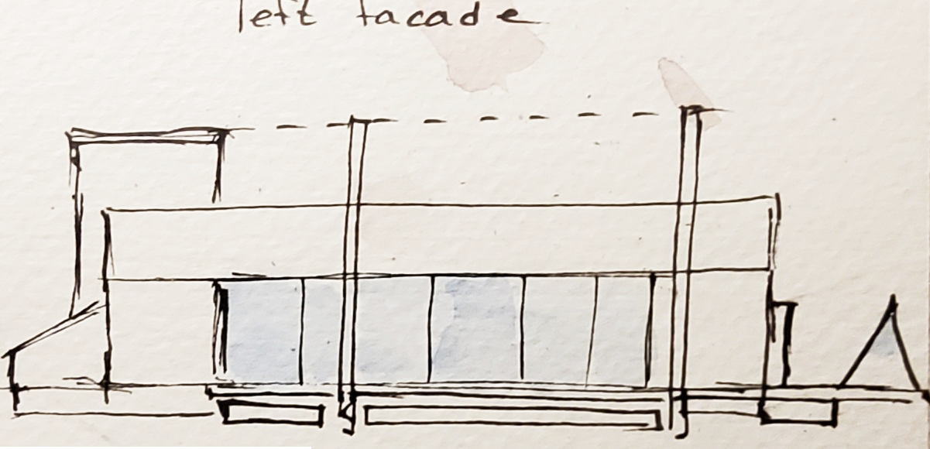
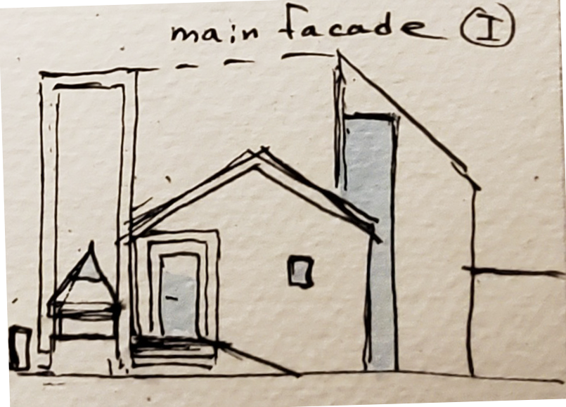
Facades

Slide 7
Interior structure

