Slide 1
Babilonia's Brief
The squares’ problem

Slide 2
Project overview and background
Our society is influenced by social apps, usually when someone meet another person, first things he/she checks his/her Instagram/facebook profile. This behavior reduce the direct human interactions.
In Naples, situated in the storic part of the town, there is Bellini Plaza surrounded by many universities. The Plaza is famous for its clubs and bars. In Bellini Plaza we can find different kinds of people like university students, LGBT+ and young alduts.
We want a project that improve the permanency in plazas/squares taking inspiration from Marco Casagrande urban works (for example Bug Dome by WEAK! in Shenzhen, Cina). The project has to be in line whit the environment and has to influence gently the public space.
We want something implemented in Bellini plaza and can be exported to every plaza/square where social activities are taken.

Slide 3
Foreign students' opinion
"Before arriving in Naples, we had already heard about the famous Piazza Bellini It is a square where Erasmus people meet and meet Italian people. It is a place with a very good atmosphere, and it is always full. You have the option of being in the street talking to people or also of sitting in a bar to have a Spritz."

Slide 4
Go around the plaza
https://www.google.it/maps/@40.8498021,14.2519475,3a,75y,70.88h,72.77t/data=!3m6!1e1!3m4!1sgGmp4q860b0vvXo-hcm4MA!2e0!7i16384!8i8192

Slide 5
Project Overview and Background

Slide 6
Target user
Teenager (16-24 years)and young adults (25-34 years) that frequent Bellini plaza (usually 6pm- 4am)

Slide 7
PERSONAS

Slide 8
Market
A physical structure
A free app (optional)

Slide 9
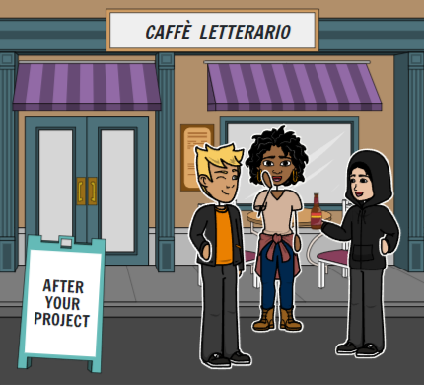
Scenario

Slide 10
Design requirement
Washable
Sturdy
Intuitive
Eco friendly if possible
Consistent with the context
Interactive

Slide 11
Facilities
Materials:
Resistent materials
App Prototype:
Balsamiq
Sketch
Marvel
Illustrator
App Develop:
Unity 3D
Blender

