Slide 1
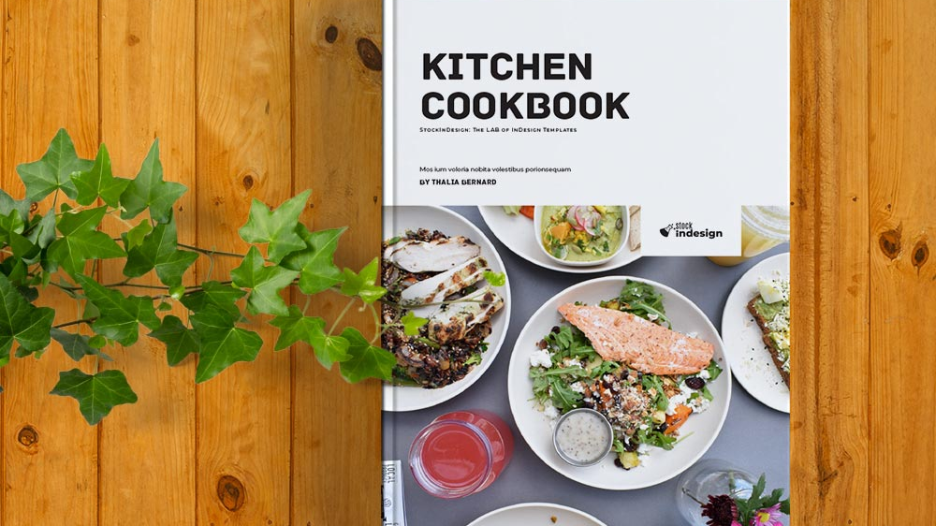
Recipe Book
Traditional Italian recipes

Slide 2
1. recipe book
A book with traditional recipes
Beautiful cover
«rub the page» feature- it let’s you feel the smell on the paper if you rub a sticker
QR-code for the web-site with the digital version of the recipe and videos of how to cook it- on the bottom of the page
Additional space for making notes and putting down own recipes

Slide 3
Beautiful cover
In creating a hardcover, the following materials are usually used:
Cardboard
Vinyl
leather (artificial or natural)
Polymers
Fabric
laminated paper cover (when using an all-planned binding).

Slide 4
Beautiful cover
As for the glue, it is used for processing blocks, in particular, with its help, the spine is glued, as well as the captal, paper and other elements are glued to it. It is often used to obtain complex bindings with block inserts.
Good glue can be determined by such indicators as viscosity, which is usually denoted mPa / s, as well as its solid content (indicated as a percentage). If we compare the gelatinous composition and the dispersion one, which is used for manual work, then the first has a viscosity of 900 mPa / s, and the second up to 19,000 mPa / s, which is much higher.

Slide 5
Rub The Page
Usually “Rub The Page” feature is used in magazines to show a customer the perfume before buying it so he can feel the smell and will to buy a product.
As for Cooking book, we were thinking that specific aromas will create the will to immediately start preparing the dish.

Slide 6
Creating a web-site
Web-site should contain videos of how to prepare dishes, which ingredients to buy. It can be created in Tilda.cc
The book would have a QR-code for the web-site

Slide 7
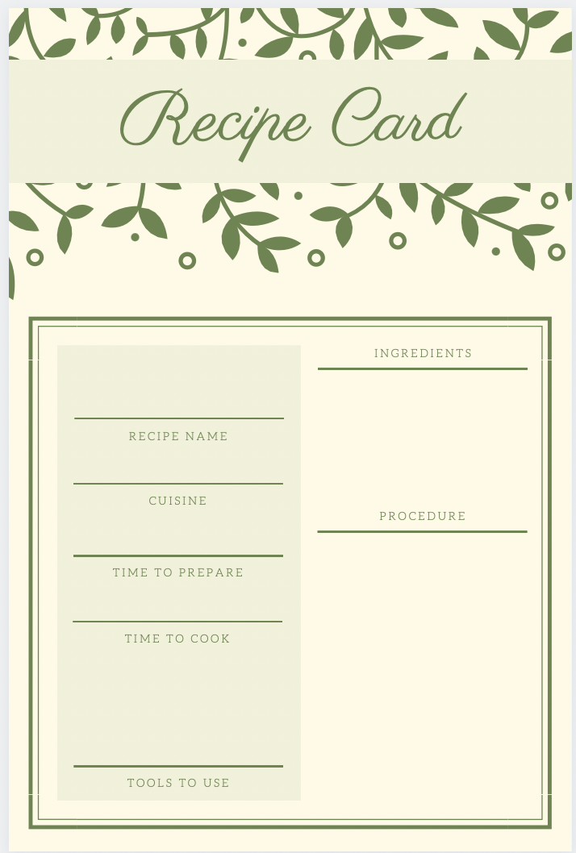
Additional space for notes
Every housemaid has her\his own family recipes that can be captured in this book as well.

Slide 8
Old recipes have been left back in past and we want to remind people sweet tastes of favorite dishes through 5 senses.
The five basic sensory systems:
1. Visual (Beautiful cover)
2. Auditory (QR-code for the web-site with the digital version of the recipe and videos of how to cook it- on the bottom of the page)
3. Olfactory (smell) System (rub the page and then cooking)
4. Gustatory (taste) System (great taste of food)
5. Tactile System (the materials the book is made of)

